Slide 1
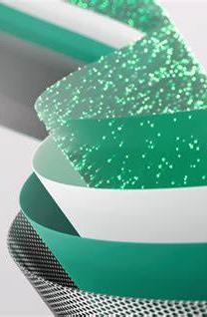
Microsoft Fabric: Data Mesh Architecture
Marc Bushong
Sr Cloud Solution Architect @Microsoft
www.linkedin.com/in/marcbushong

Slide 4


Get your SQL Questions answered here by our SQL Experts
(Across from Registration)

Slide 5

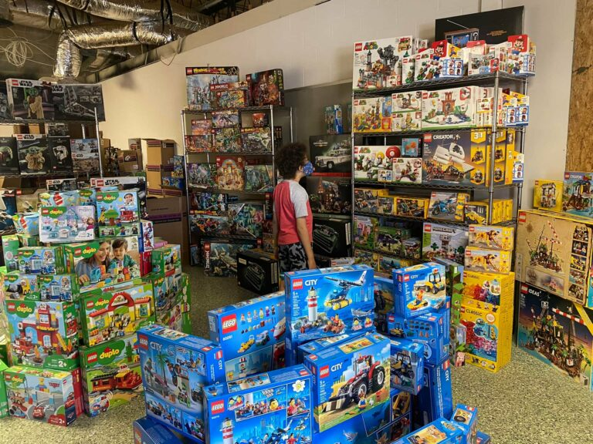
501 Legion Charitable Donation & LEGO Drive
Thank the 501 Legion for Supporting Our Event!
JSSUG Will Match Donations up to $1000
Donation Bucket on Registration Table
LEGO donation on V for Victory Table

Slide 6
Costume Contest Rules
1. Take a picture with the SQL Saturday Backdrop during the event
2. Post the picture to Twitter/X and include the hashtag #SQLSatJax24CC
3. The tweet using the hashtag that has the most "likes" wins a prize!

Slide 7
Session Evaluations
Your feedback is important to us!
Please fill out and hand to speaker after the session!

Slide 8
Event Evaluation
Fill out event evaluation card in your bag and visit all sponsors to be entered to win an Xbox Series X – (Must be present to win)

Slide 9
Agenda
Data Mesh Crash Course
Microsoft Fabric Relevant Components Overview
Data Mesh in Fabric
Architecture Patterns
Q/A

Slide 10
What does Data Mesh even mean?
Data mesh is an architectural pattern for implementing enterprise data platforms in large and complex organizations.
Data mesh helps scale analytics adoption beyond a single platform and a single implementation team.

Slide 11
Foundational Concepts for Data Mesh Architecture
Data Domains
Data Products
Self-serve Platforms
Federated Governance

Slide 12
Data Domains
Foundation of Data Mesh
Decentralization and the distribution of responsibility to domains
Defines boundaries around your data/functionality
Long term ownership.
Match reality and not just theoretical concepts.
Atomic integrity.

Slide 13
Data Domains
Think but don’t overthink it…
You probably already have domains but you just don’t call them that or haven’t noticed.
Every organization is different.
If you are having trouble, think more abstract
Many types of domains
Application domains, data domains, source system domains, consumer domains, etc.

Slide 14
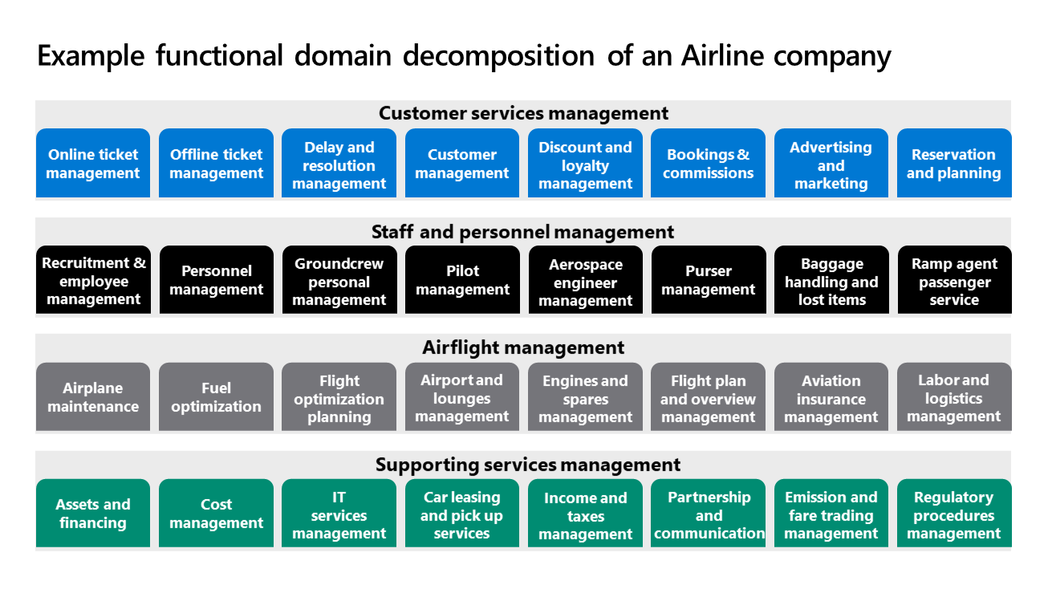

Slide 15
Data Products
Data is the product…
Application owners/teams treat data as fully contained product
Data Products in Data Mesh prevents some common integration issues
Think if some underlying data in a report changes, it changes the way the business might make decisions off it.
The “That is not my department” issue…
Which still may be valid

Slide 16
Well Designed Data Products
Discoverable, understandable, and trustworthy
Addressable, natively accessible, and secure
Interoperable, truthful, and valuable

Slide 17
Data Products Design Recommendations
Might need to acquire new set of skills or new tools and platforms.
Focus on the data as a product’s needs
Services may differ from other domains
Or they can be shared!

Slide 18
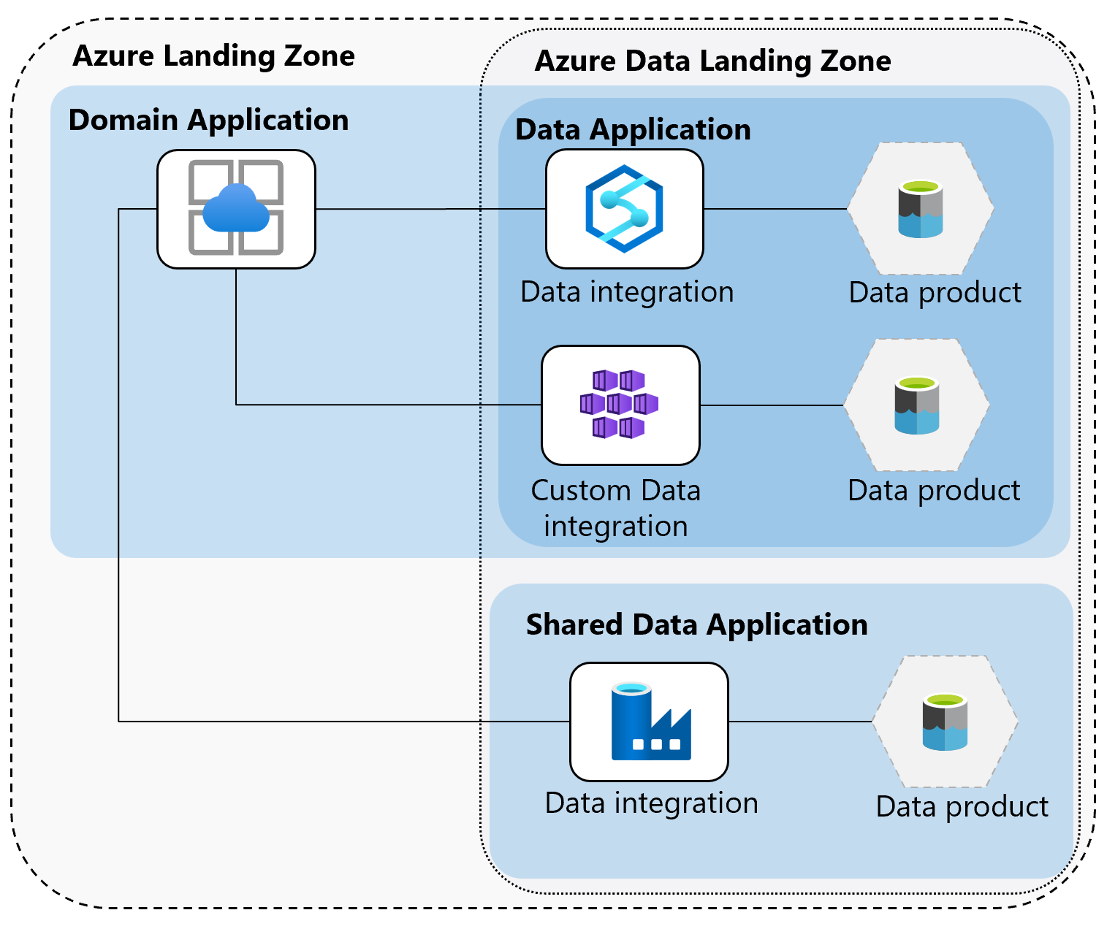

Slide 19
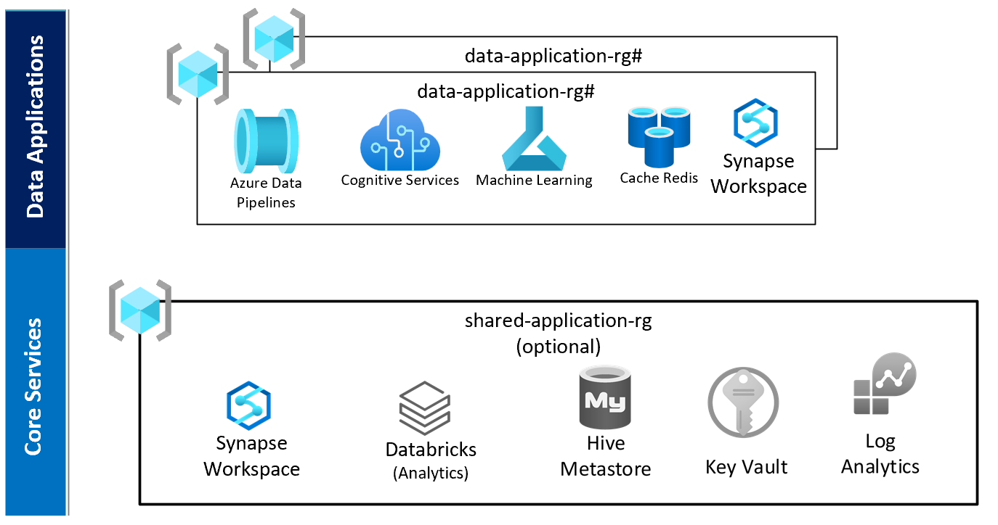

Slide 20
Self-Serve Platforms
Fancy for letting domains/teams/users operate independently
No strong dependency on central platform or team.
Central team can still exist in a capacity, but they are not causing impediments to self serving.

Slide 21

Federated Governance
Lack of governance leads to bad things
Silos and data duplication to name some
Federate the governance to the domain owners/admins
Align governance experts with the data owners/domains
Governance is a larger topic and won’t dive too deep for this.

Slide 22
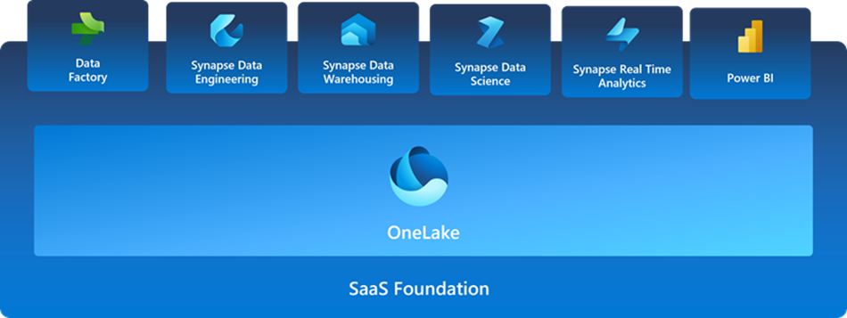
What is Microsoft Fabric?

Slide 23

Key Components in Fabric for Data Mesh
All Fabric Components
Reason is the mix and match for the data products
OneLake Data Hub
Domains
Governance
Microsoft Purview
Especially Shortcuts and Mirrored DBs

Slide 24

Fabric Administration Components
Tenant
Capacities
Workspaces
Artifacts
All components. Including features like Shortcuts & Mirroring

Slide 25
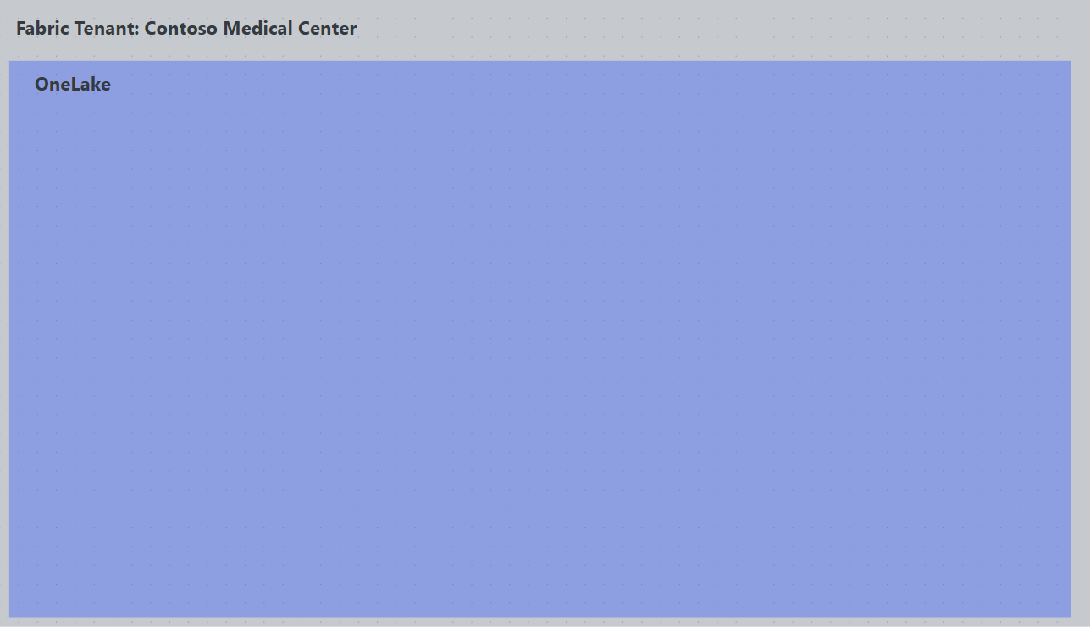

Slide 26
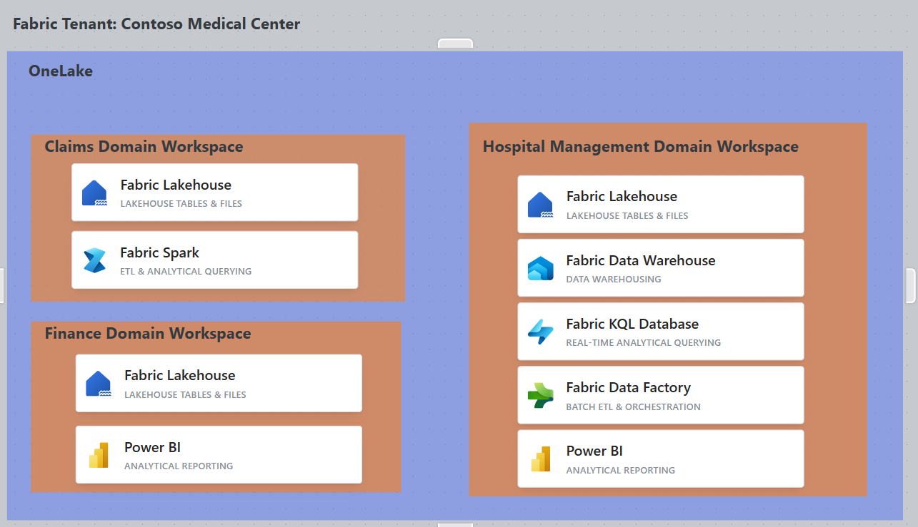

Slide 27
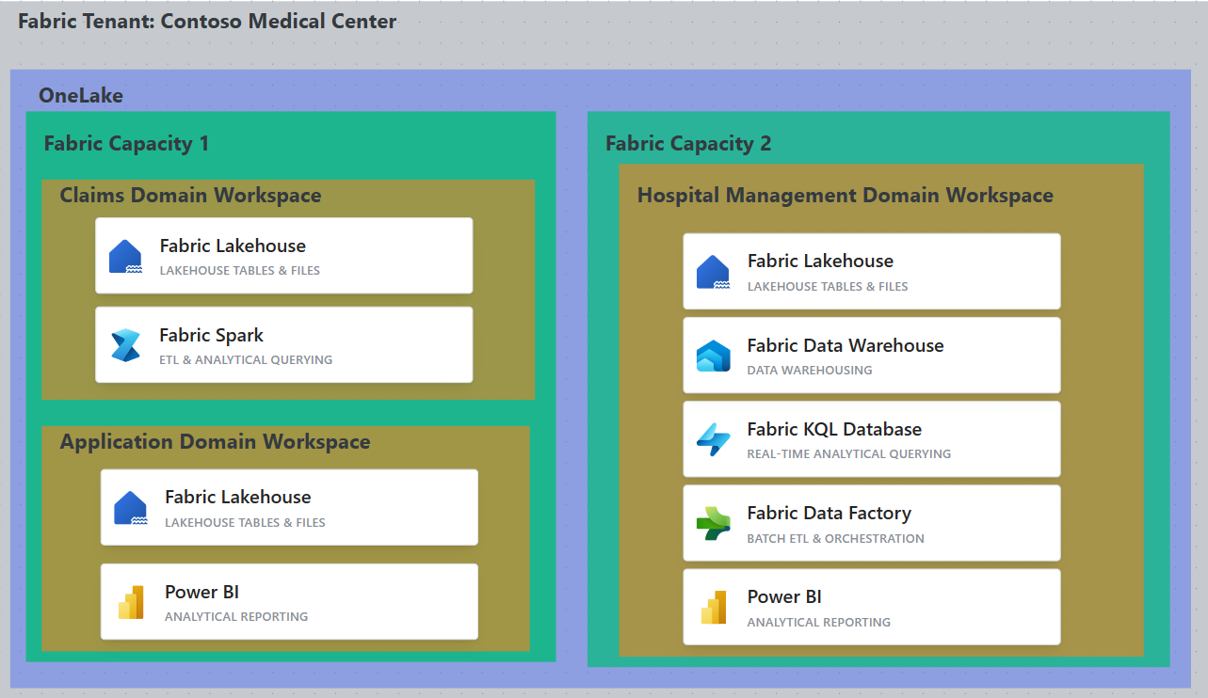

Slide 28

Data Mesh in Fabric
All components of Data Mesh Architecture Exist
Domains
Fabric offers delegation to domains for data management and governance.
Subdomains
Data Products
No more need for multiple services in the product. Can build on existing products as well.
Self-Serve Platforms
Federated Governance
OneLake Data Hub & Purview is the one stop shop for data discovery and registration.
Remember though - Bad data in bad data out
Only covering Domains in our discussion
Purview contains Data Products in Data Management

Slide 29
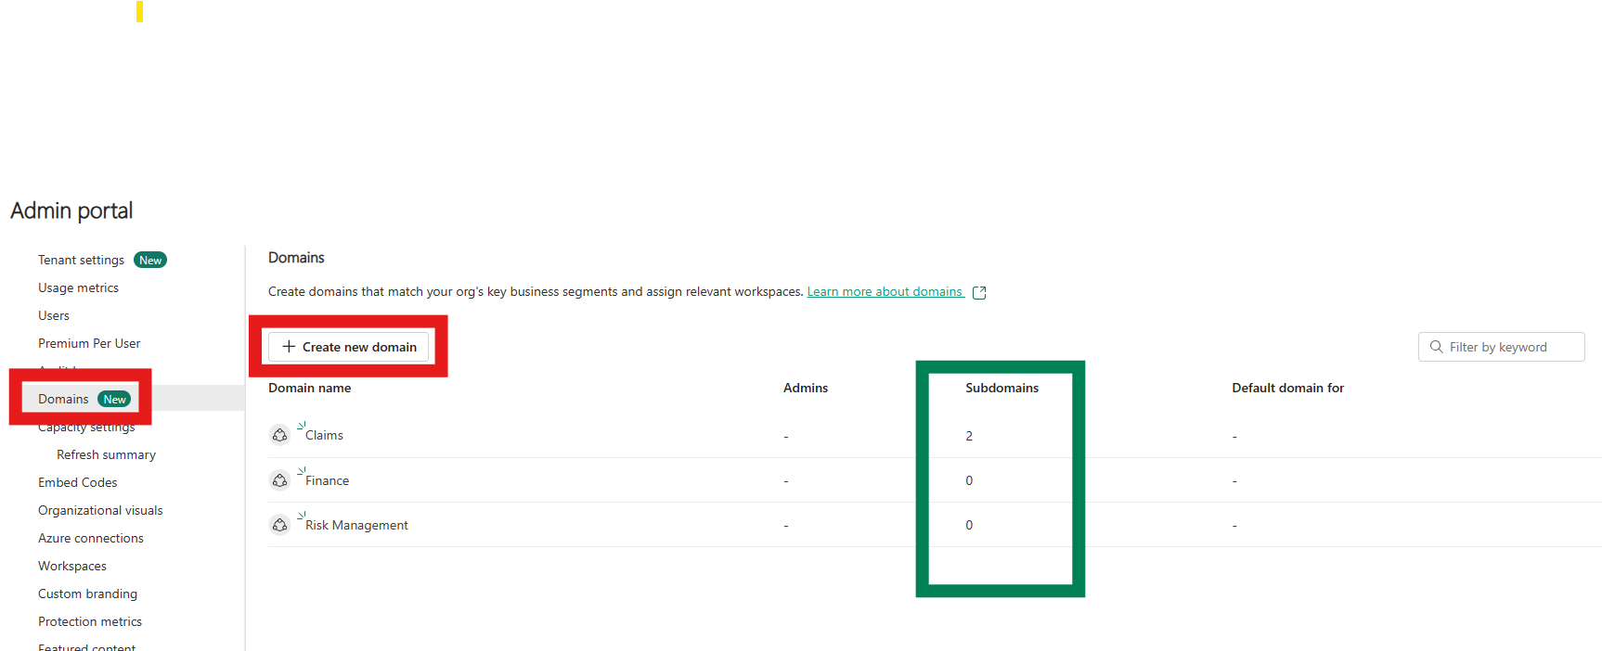

Slide 30
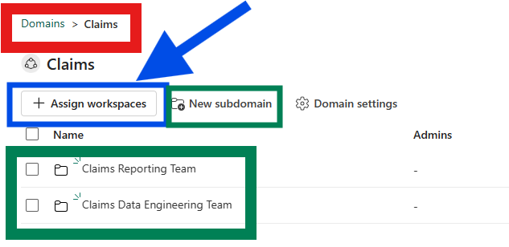

Slide 31
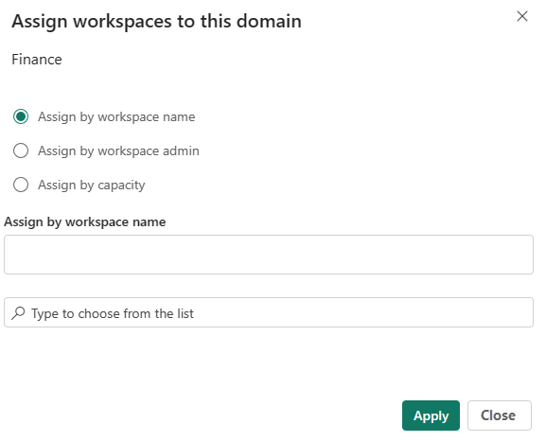

Slide 32
Architecture Patterns
Medallion Architecture Review if needed
Different Architectures of Data Mesh

Slide 33
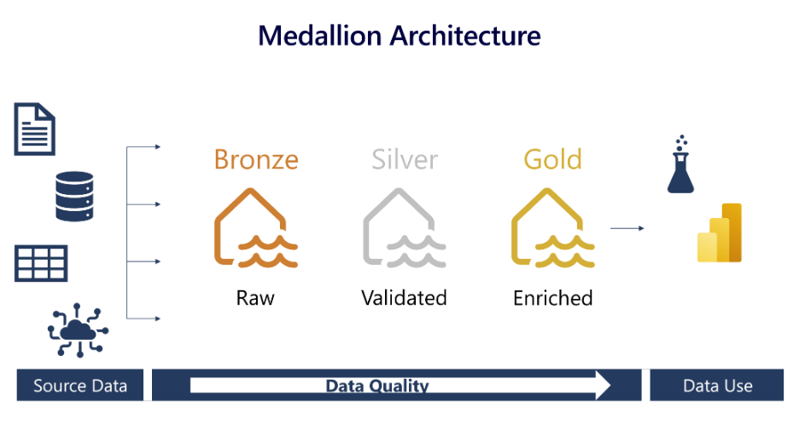
General Medallion Architecture

Slide 34
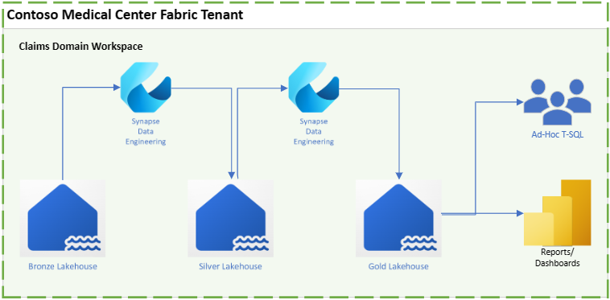

Slide 35
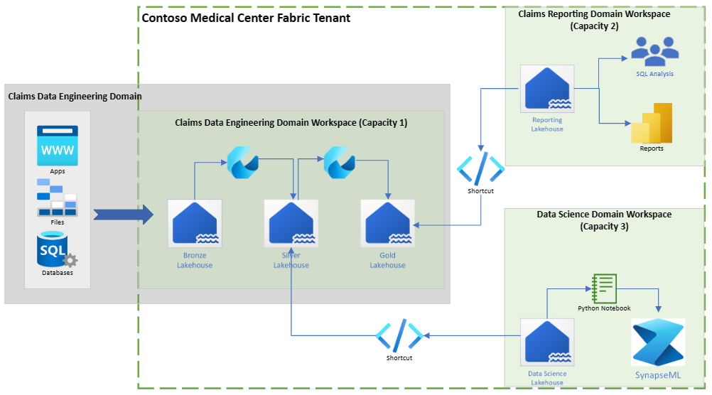

Slide 36
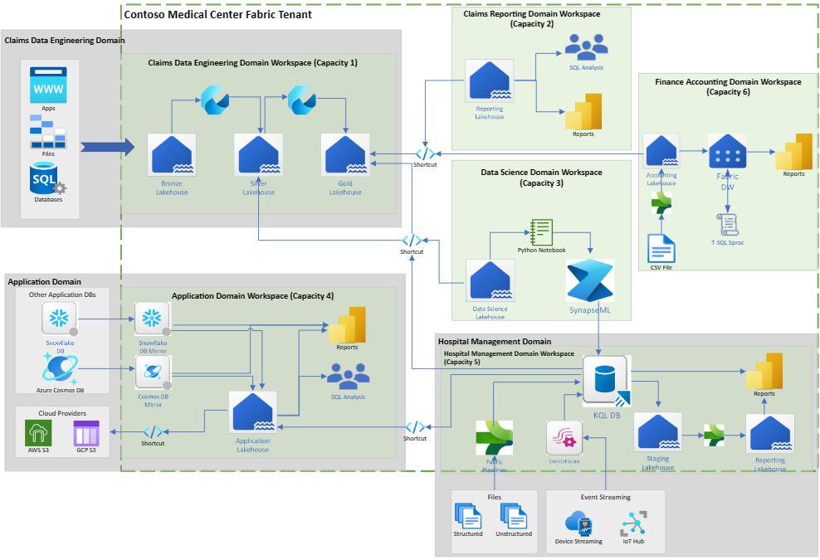

Slide 37

Helpful Tips for Moving Forward
This is just the beginning of the journey.
Master Data Management
Data Governance Strategies
Many more not covered here
Must have a well-defined strategy for implementation
Iron out use cases, scaling strategy, and objectives
Good idea to have dedicated team or program board to oversee the process
Start small and simple
Clear concise use case and skills already in house

Slide 38

Questions?

